Slide 1
Applicability of Risk Management
Moudud Alam
School of Information and Engineering/Statistics
Dalarna University
10/09/2021
1

Slide 2

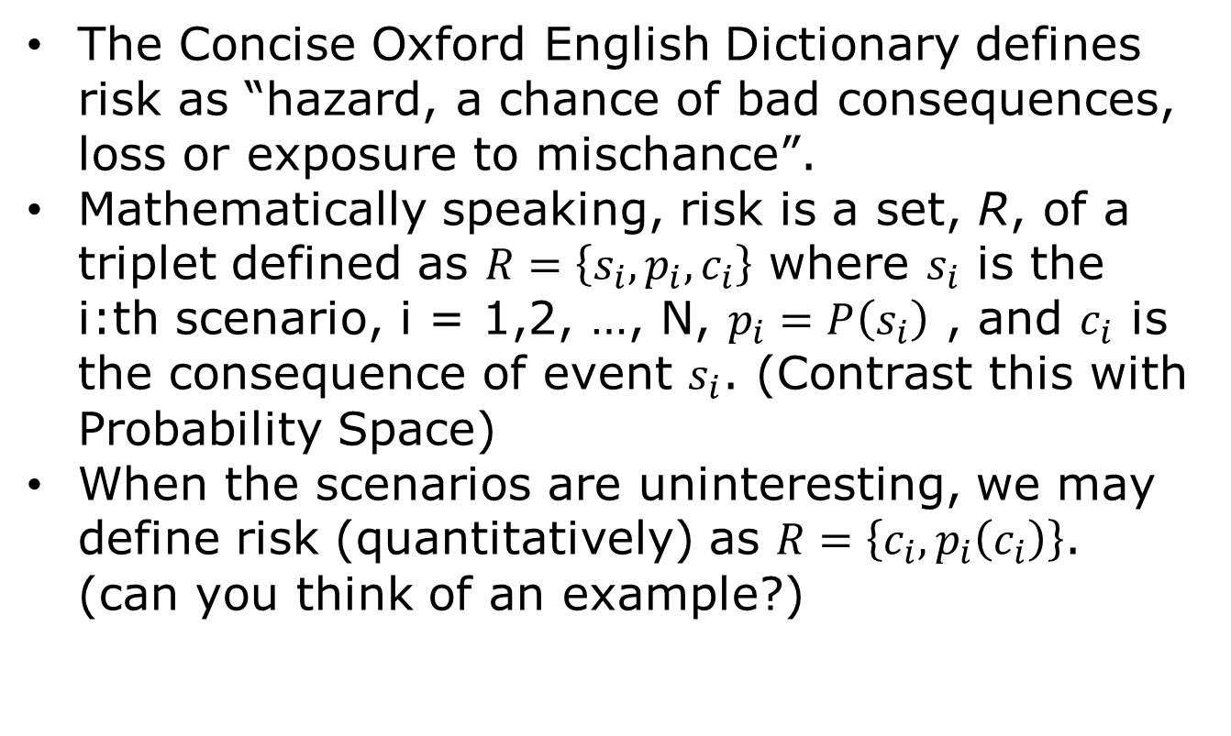
Review: What is risk?
The Concise Oxford English Dictionary defines risk as “hazard, a chance of bad consequences, loss or exposure to mischance”.
Mathematically speaking, risk is a set, R, of a triplet defined as $R=\left\{s_{i},p_{i},c_{i}\right\}$ where $s_{i}$ is the i:th scenario, i = 1,2, …, N, $p_{i}=P\left(s_{i}\right)$ , and $c_{i}$ is the consequence of event $s_{i}$. (Contrast this with Probability Space)
When the scenarios are uninteresting, we may define risk (quantitatively) as $R=\left\{c_{i},p_{i}\left(c_{i}\right)\right\}$. (can you think of an example?)

Slide 3
What is Risk Management?
It is a process to:
Identify all relevant risks
Assess / rank those risks
Address the risks in order of priority
Monitor risks & report on their management
2

Slide 4

Risk Management – why do we need it?
May be obliged by law, depending upon industry or sector (e.g. Basel II accord for banks).
❑ Tax gain: Corporate taxes are paid in a progressive and yearly basis. A company cannot take last year’s loss into account to reduce current year’s tax.
❑ Reduce bankruptcy cost.
❑ Reduce compensation package: The company might need to pay higher compensation to hire an employee when people see that the company is in risk of bankruptcy.
3

Slide 5
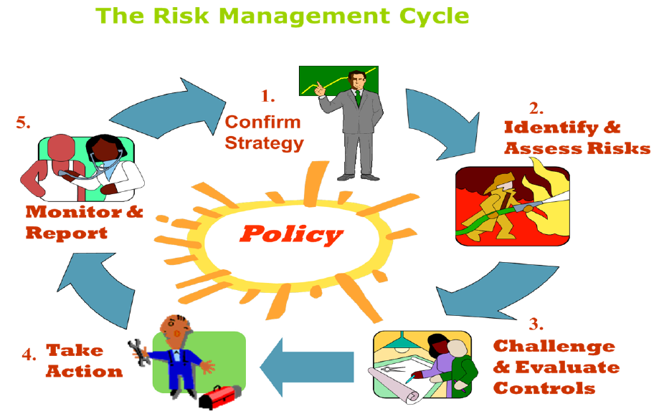
Risk Management Cycle
4

Slide 6
Risk Management Cycle- Step 2
Risk Identification – what are the threats and uncertainties associated with my organization’s or units objectives?
• Separate out the risk into its cause & possible effect
• Be concise & clear
• Do not concentrate on symptoms only

Slide 7
Risk Management Cycle- Step 2 cont.
•Assess the risk’s
Impact
Likelihood
(Guidance on both later!)
•Prioritize the risks
•Hint: Get input from appropriate individuals

Slide 8
Risk Management Cycle- Step 3
Challenge & Evaluate Controls
Control: Policy, action, procedure or process designed to prevent risk or to limit its impact
Do they work, are they effective?
Residual Risk only should be measured

Slide 9
Risk Management Cycle- Step 4
Take Action!
For serious risks where controls are
A) Weak
B) Absent
❑ For risks where the Risk Appetite is exceeded
❑ Examine Cost vs. Benefit

Slide 10
Risk Management Cycle- Step 4 cont
Types of Action
A)Tolerate
B)Treat
C)Substitute
D)Terminate
(The choice of the above will be decided upon by your risk appetite)

Slide 11
Risk Management Cycle – Step 5
Monitor & Report
Use a standard format for capturing risk data e.g. a “Risk Register”
Review all risks at least annually
Serious risks to be reviewed more often depending on circumstances
Report on risk to senior management / Board
Make Risk Register available to stakeholders to show good governance
10

Slide 12
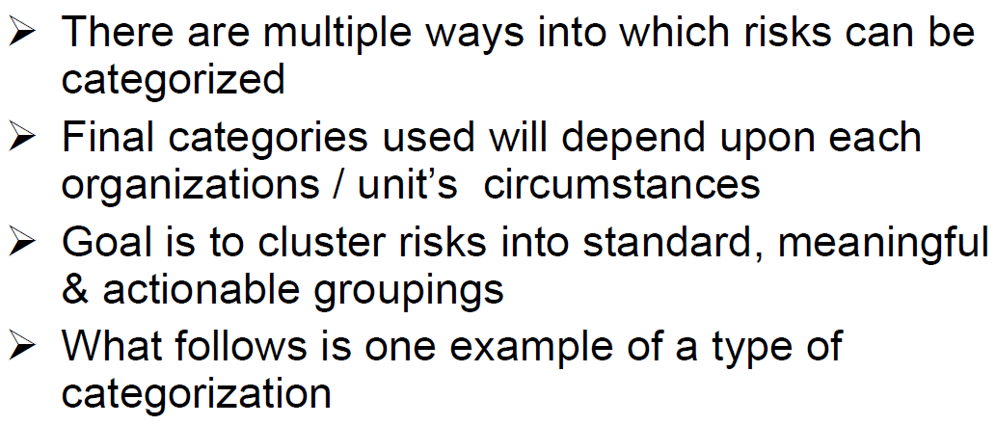
Categories of Risk
11

Slide 13
Categories of Risk Cont.
Financial risk
Liquidity risk
Credit risk
Market risk
Model risk

Slide 14
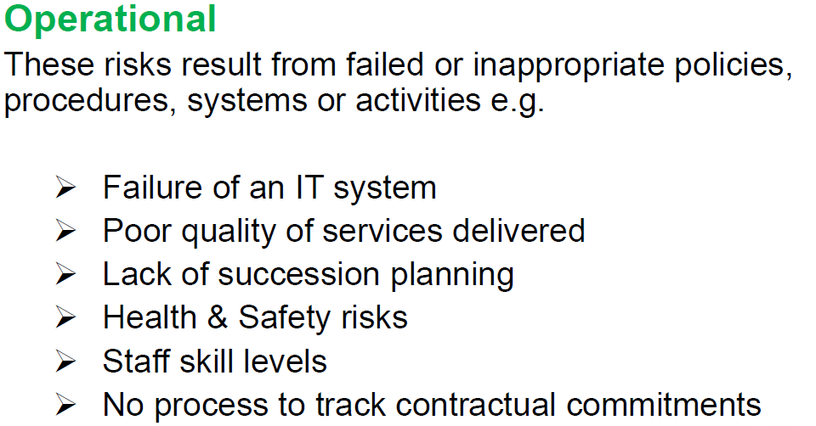
Categories of Risk Cont.
13

Slide 15
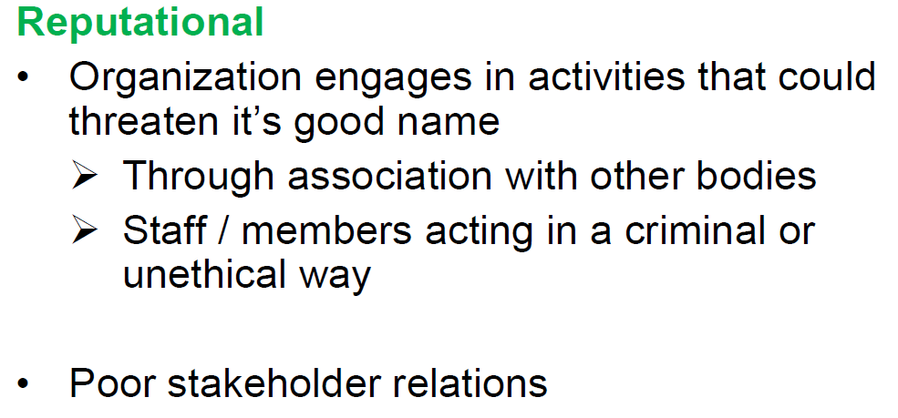
Categories of Risk Cont.

Slide 16
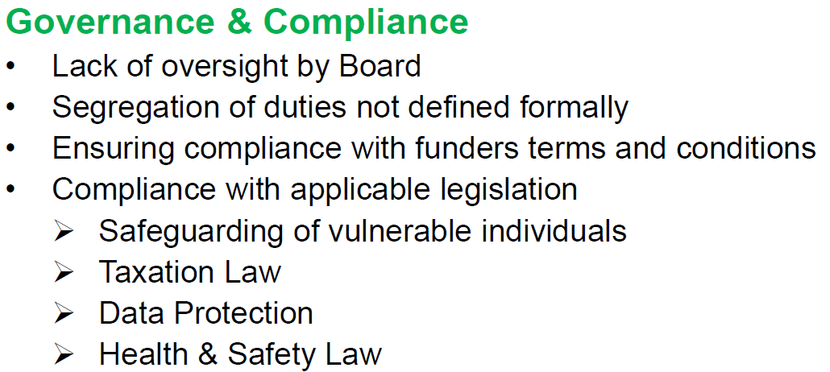
Categories of Risk Cont.

Slide 17
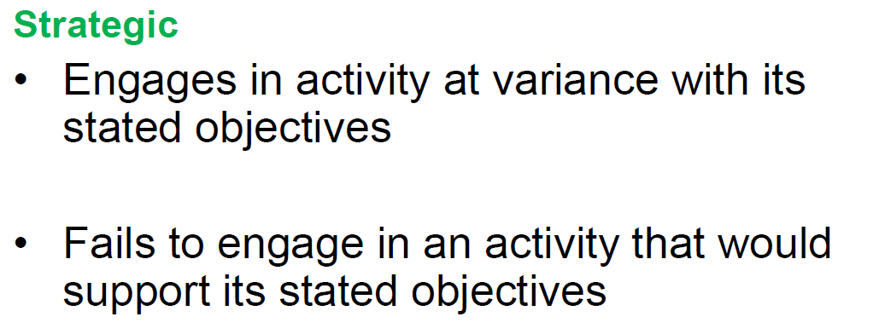
Categories of Risk Cont.

Slide 18
Risk Assessment Methods
Risk Register
Risk Matrix
Statistical Methods
Multi-Criteria Decision Model (MCDM)

Slide 19
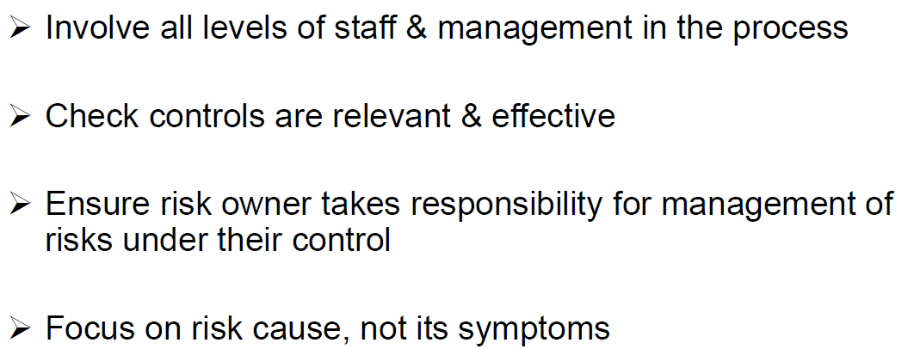
Tips for Success

Slide 20
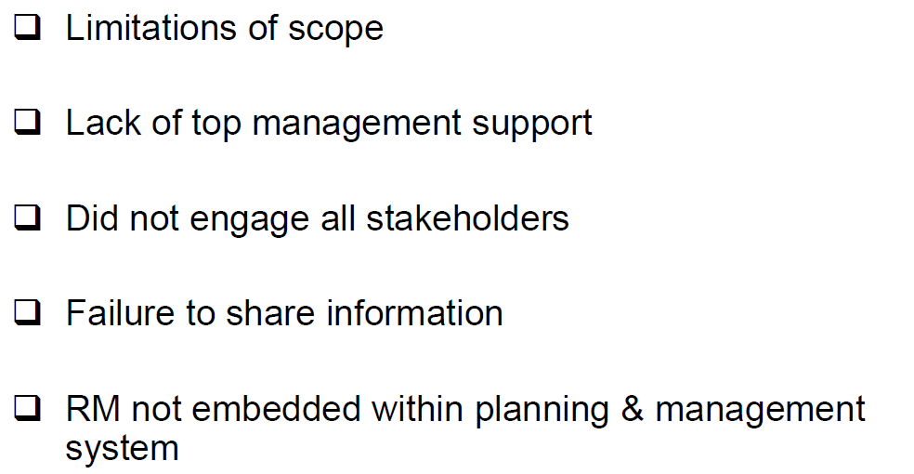
Why Risk Management may fail

Slide 21
Criticism of risk management
Risk-management can be costly.
Over confidence on models may lead to even bigger unexpected loss.
Risk management herding can take place: All the companies adopted the same risk management system might fall into the same problem in special crisis situation.

Slide 22
Assignment 1-Discuss Papers
This assignment is accomplished in the following two steps.
Read Cox (2009, 2011), and Haimes (2009) and then write a critical reflection on these articles (max. 2250 words). Deadline for this task is October 26; 23:59 CET (see Learn for further information).
Write a critical review on another group’s reflection, and present it in a seminar on October 8. While criticizing others’ work, highlight the dissimilarities and similarities with your work. Which group’s work do you need to review, will be notified via Learn by Sep. 27.
Both assignments are conducted in groups. See Learn for the list of groups. It is sufficient that one from each group uploads the solution on Learn.
Add a cover page to your solution indicating who you are, and what is this about.
This assignment is graded on a U-G scale (fail and pass).
Every student should contribute equally. You should notify Moudud Alam in case a member of your team did not contribute as much as expected.
For any further questions contact Moudud Alam (maa@du.se)

Slide 23
References
Aven, T. (2015). Risk assessment and risk management: Review of recent advances on their foundation, European Journal of Operational Research, 135, 1-13.
Chistoffersen, P. F. (2012), Elements of Financial Risk Management, Academic Press, Oxford, UK.
Cox Jr., L. (2009). What's wrong with hazard-ranking stems? An expository note: Perspectives. Risk Analysis, 29(7), 940-948.
Cox Jr., L. (2011). Clarifying Types of Uncertainty: When Are Models Accurate, and Uncertainties Small? Risk Analysis: An International Journal, 31(10), 1530- 1533.
Haimes, Y.Y. (2009). On the complex definition of risk. A systems-based approach. Risk Analysis: An International Journal, 29(12), 1647-1654.

